Slide 1
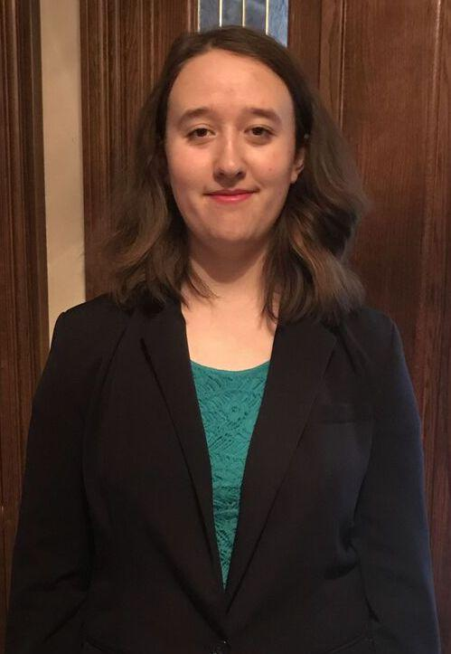
Jenya Lestina
Personal pitch deck
August 2018

Slide 2
An artist in code
I have a passion for creating elegant solutions to complex problems.
I’ve built websites the way Iron Man built his first suit: with spare parts and by hand. I taught myself web development, SQL, Java, and more.
Now I want to use these skills to help you.

Slide 3
Experience
I created the website for http://speset.com/, which includes a mailing list form. Speset now has over 100 subscribers to their mailing list, using no marketing besides the on-site content. They can use this mailing list to alert subscribers when a new book comes out.
Notes:
Speset sells school-supplement or school-alternative resources for children grades K-8.

Slide 4
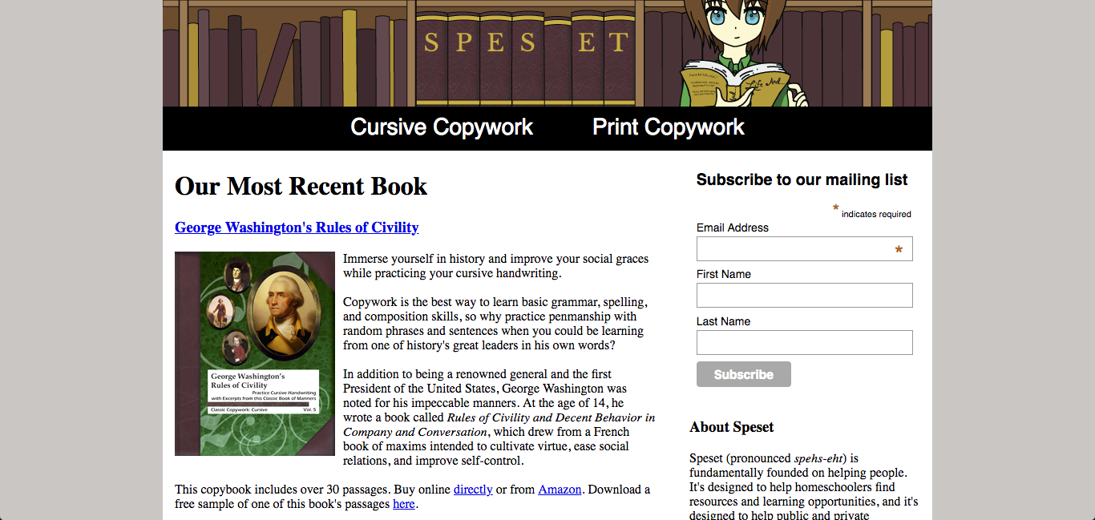
Projects
My mother owns several businesses, and as such I’ve been working for her and her clients for a number of years
now. One of my biggest projects was the creation of the Speset website, including graphics and integrated mailing list. This is a better option for the business than simply putting their books on Amazon, since customers can see all their products in one place.

Slide 5
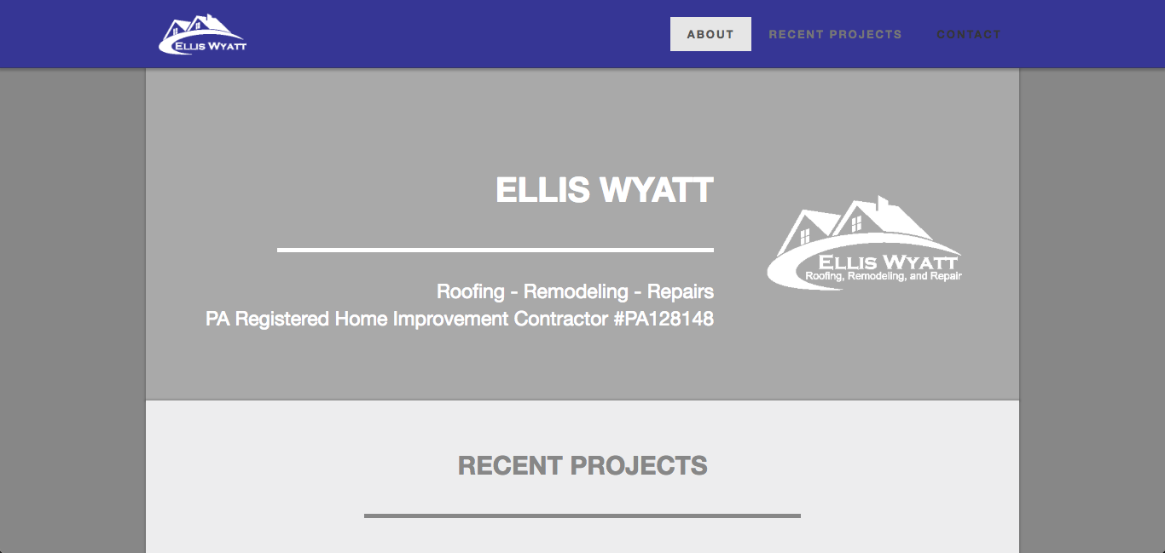
Projects
I helped to create the website for Ellis Wyatt, a roofing company. The webpage helps the growing company to attract potential customers and increase publicity.

Slide 6
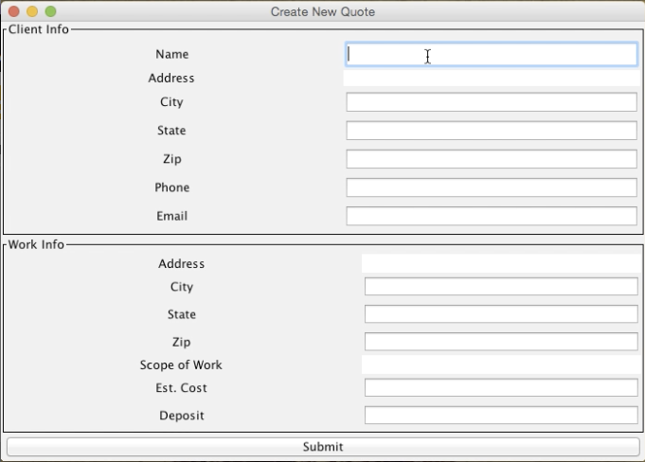
Projects
This is an input screen from the front end for an application that will eventually be used by roofers at Ellis Wyatt to create quotes for customers. This solution will improve the way roofers create quotes: before, they created quotes by typing information into Excel.

Slide 7
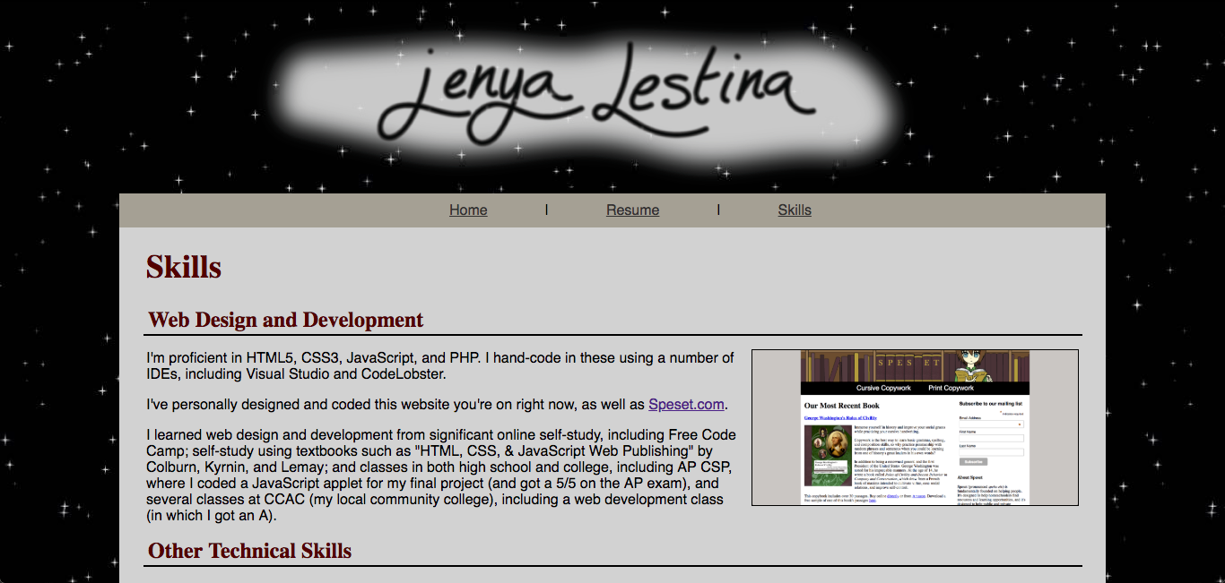
Projects
This is most recent project is my personal website. It’s designed to show all my skills in one place and to be an
interactive example of my web design and development skills. This was the main reason I decided to hand-code it instead of creating it with a service like SquareSpace or WordPress, even though hand-coding took much longer.

Slide 8
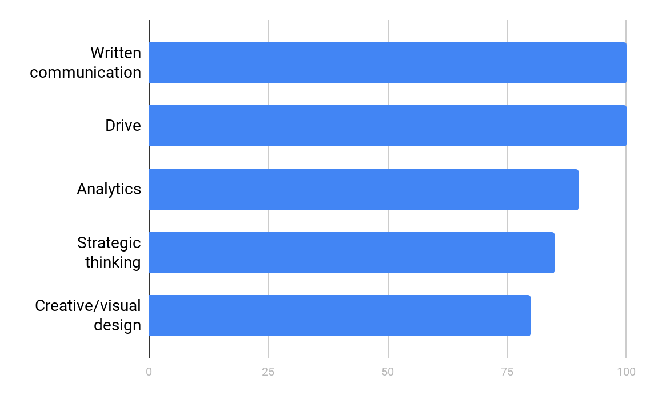
Top Soft Skills

Slide 9
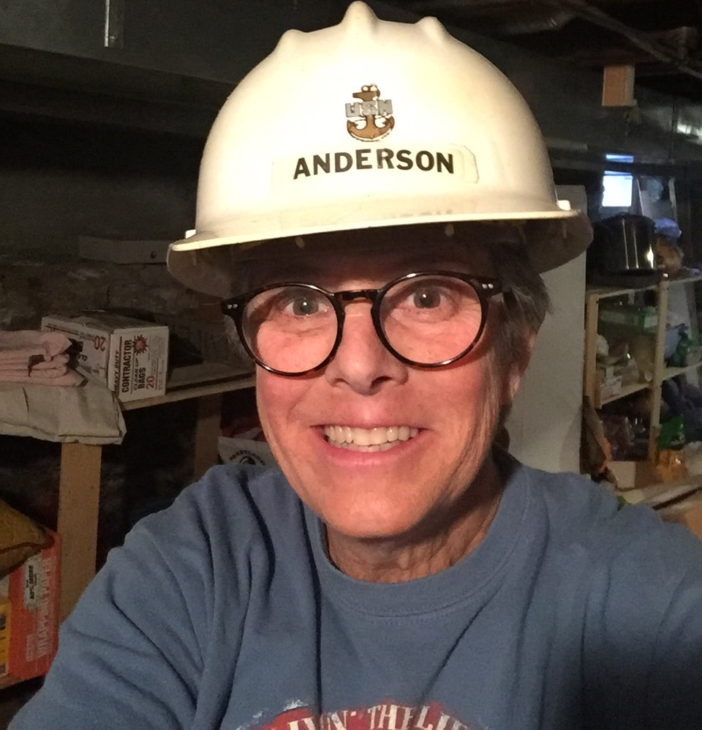
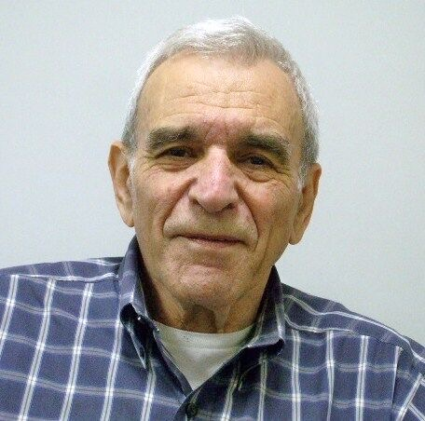
Endorsements
Jenya in the development of the Web page for Ellis Wyatt Properties displayed intuitive insight into the needs of our company. With input from the Ellis Wyatt Team, she developed a clearly designed page with meets our needs and is helping us build our business.
Lisa Anderson, partner at Ellis Wyatt Properties, LLC
Jenya is bright, energetic, enthusiastic, and a joy to work with. For the last few years she has helped me in a variety of ways. She proofed many of my documents and proposals, helped build or improve several web sites, and helped create several excellent powerpoint presentations. We also had many discussions about the companies I was working with and the world of business in general. She asked good questions and is eager to learn. I look forward to continuing to work with Jenya.
Robert Polak, serial entrepreneur and President of Future Tech Now

Slide 10
I look forward to working with you!
LinkedIn: jenya-lestina
jenyalestina.com
412-477-0566

